Slide 1


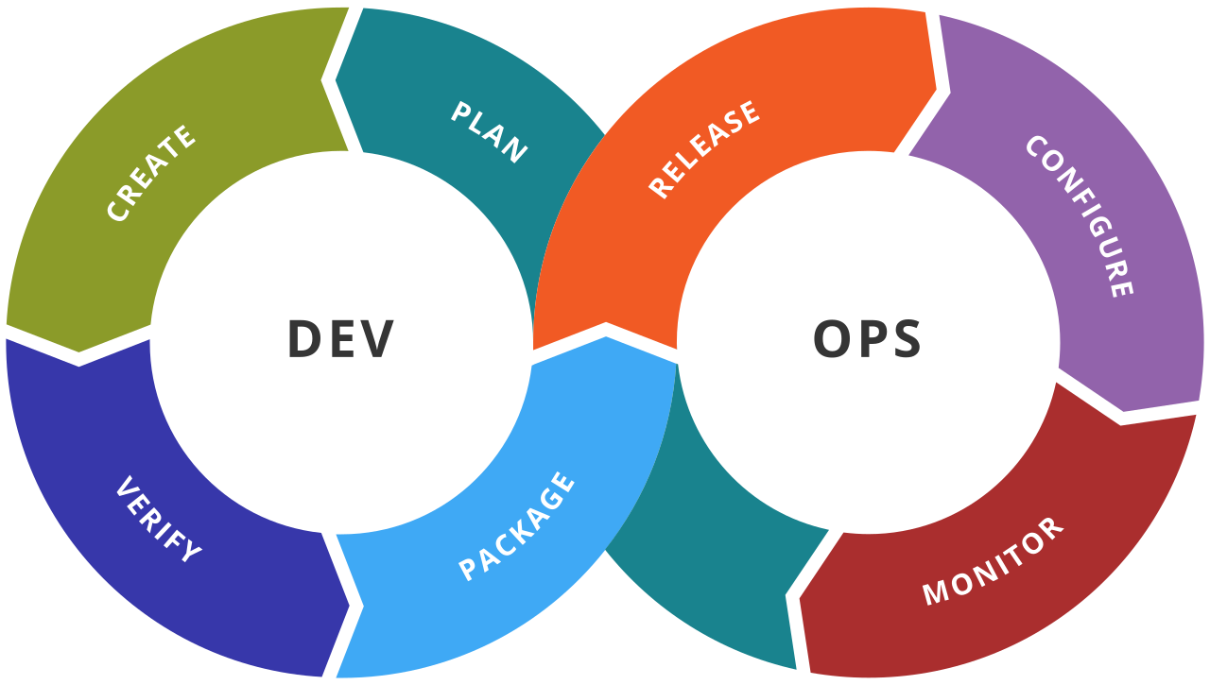

AWS DevOps
Notes:
Welcome back to the forth module of data science.

Slide 2
Agenda
01
What is AWS?
02
What is DevOps?
03
Introduction to AWS DevOps
04
AWS Developer Tools
05
Creating a DevOps lifecycle using AWS DevOps tools
06
Summary

Slide 3
What is AWS?

Slide 4
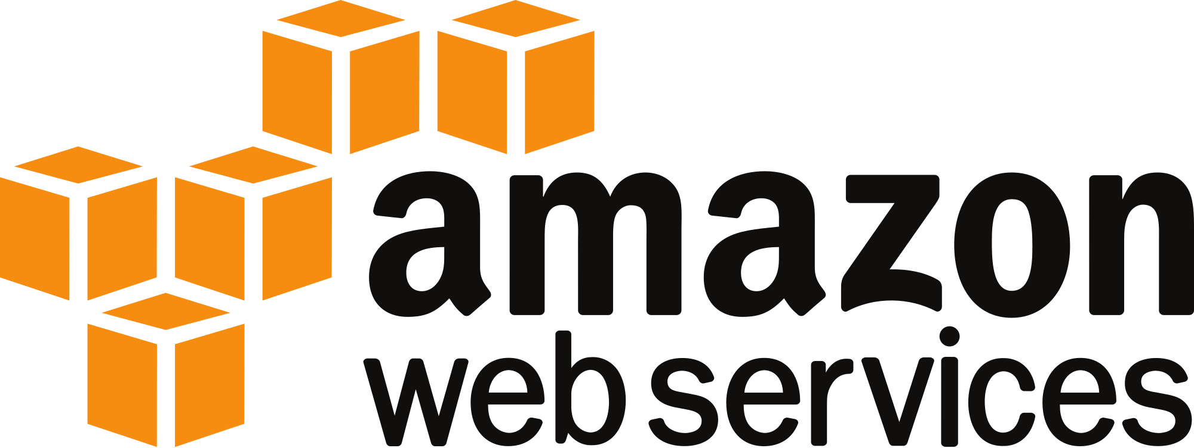
What is AWS?
AWS is a platform which helps businesses scale and grow by offering secure cloud services like compute power, content delivery, database storage, and other functionality.

Slide 5
What is DevOps?

Slide 6
What is DevOps?
DevOps is the union of people, process, and products to enable continuous delivery of value to our end users

Slide 7
Introduction to AWS DevOps

Slide 8
Introduction to AWS DevOps
AWS DevOps is a set of Developer tools which allows the user to create a CI/CD pipeline from the source to the deploy stage.

Slide 9
Why AWS for DevOps?
Built for Scale
Automation
Pay-As-You-Go
02
04
06
01
03
05
Fully Managed Services
Programmable
Secure

Slide 10
AWS Developer Tools

Slide 11

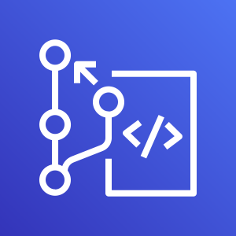
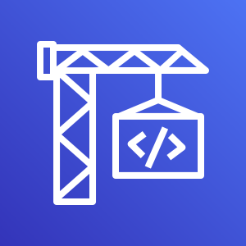
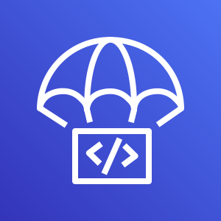
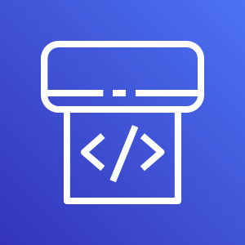
AWS Developer Tools
CodeCommit
CodeBuild
CodeDeploy
CodePipeline

Slide 12
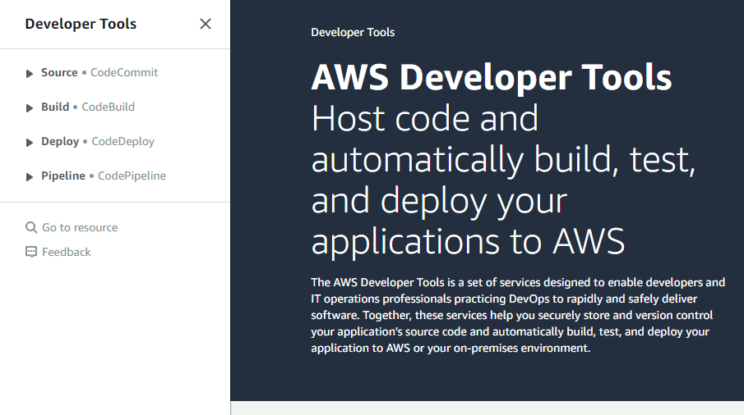
AWS Developer Tools

Slide 13
AWS CodeCommit

Slide 14
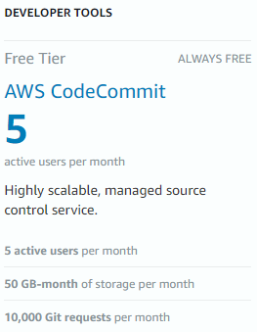
Why AWS CodeCommit
CodeCommit is a version control tool provided by AWS and it provides a lot of free features

Slide 15

Edmunds.com Case Study
Edmunds.com is significantly reducing its technology costs by running its website on the AWS Cloud. “We expect to save $32 million in the first five years by running our website and other critical applications on AWS,” says Potloff. “For a growing company like ours, it is incredible that we are able to bend the infrastructure cost curve down as we continue to expand.”
Most recently, the company started using AWS CodeCommit as its source control service for hosting 1,500 private Git repositories and more than 270 users. The company is also benefiting from its use of AWS CodeCommit, which has reduced the time the organization previously spent on administration and maintenance tasks by 95 percent.

Slide 16
AWS CodeBuild

Slide 17
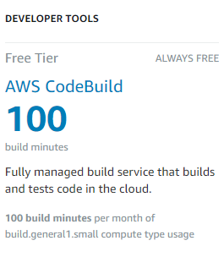
Why AWS CodeBuild
AWS CodeBuild is a fully managed continuous integration service that compiles source code, runs tests, and produces software packages that are ready to deploy.

Slide 18




Why AWS CodeBuild
Fully managed build service
AWS CodeBuild eliminates the need to set up, patch, update, and manage your own build servers and software. There is no software to install or manage.
Continuous scaling
AWS CodeBuild scales up and down automatically to meet your build volume. It immediately processes each build you submit and can run separate builds concurrently, so builds are not left waiting in a queue.
Pay as you go
With AWS CodeBuild, you are charged based on the number of minutes it takes to complete your build. This means you no longer have to worry about paying for idle build server capacity.
Extensible
You can bring your own build tools and programming runtimes to use with AWS CodeBuild by creating customized build environments and also use pre-existing environments

Slide 19
AWS CodeDeploy

Slide 20




Why AWS CodeDeploy
This is an automated deployment tool which can deploy to services like EC2, Lambda, Elastic Beanstalk, and even your on-premises instances.
Automated deployments
AWS CodeDeploy fully automates your software deployments, allowing you to deploy reliably and rapidly.
Minimize downtime
AWS CodeDeploy helps maximize your application availability during the software deployment process.
Centralized control
Through CLI and Management console, you can keep complete track of your deployments.
Easy to adopt
works with any application and same experience whether you’re deploying to Amazon EC2, AWS Lambda.

Slide 21
AWS CodePipeline

Slide 22
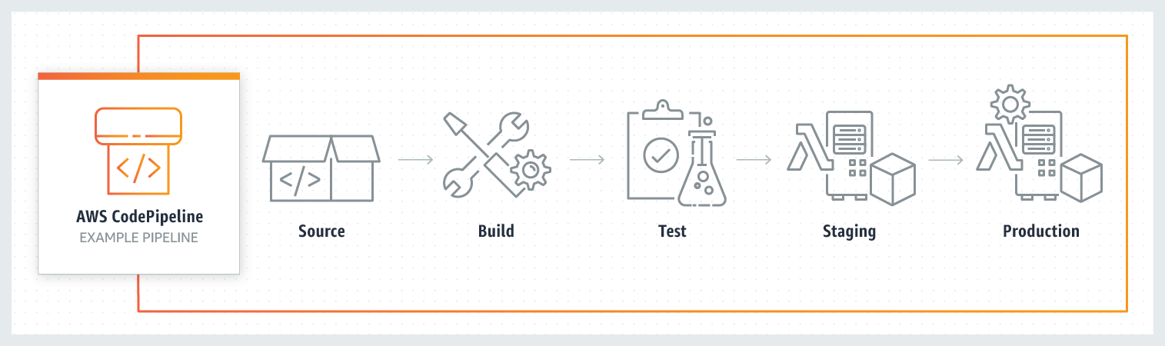
Why AWS CodePipeline
A continuous delivery tool which is fully managed by AWS which you can use to automate your releases for rapid and reliable deployment

Slide 23

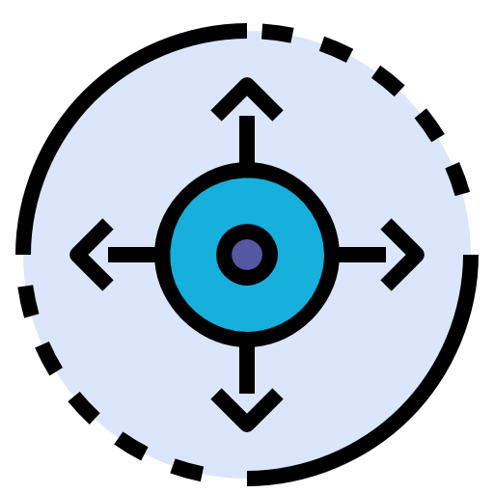


Why AWS Pipelines
Easy to integrate AWS CodePipeline with GitHub or with your own custom plugin. With AWS CodePipeline, you only pay for what you use. There are no upfront fees or long-term commitments.
Rapid delivery
Configurable workflow
Get started fast
Easy to integrate

Slide 24
Creating a DevOps lifecycle using AWS DevOps tools

Slide 25
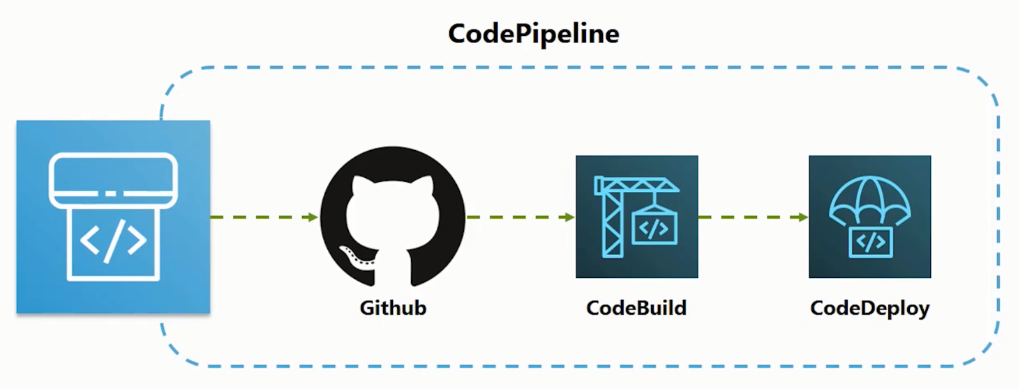
Demo: Create a CI/CD pipeline

Slide 26
Summary

Slide 27

Summary
1.
3.
2.

Slide 28
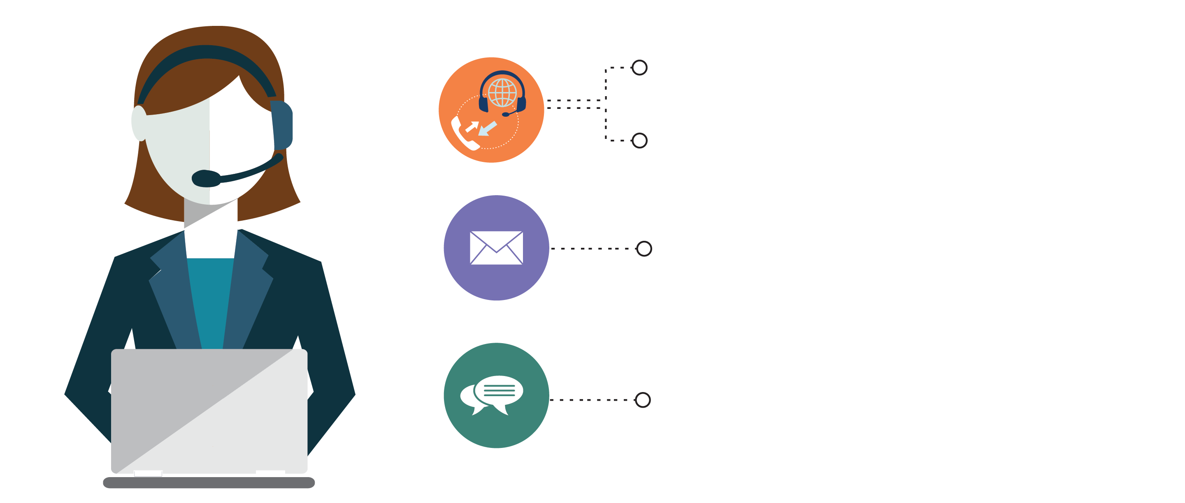
India : +91-7847955955
US : 1-800-216-8930 (TOLL FREE)
sales@intellipaat.com
24X7 Chat with our Course Advisor
Notes:
Thank you!

